Slide 1
Computer users
Volodia Kuzmenko
Group IO-21
Notes:
We designed this template so that each member of the project team has a set of slides with its own theme. Members, here’s how you add a new slide to just your set:
Mark where you want to add the slide: Select an existing one in the Thumbnails pane, click the New Slide button, then choose a layout. The new slide gets the same theme as the other slides in your set.
Careful! Don’t annoy your fellow presenters by accidentally changing their themes. That can happen if you choose a different theme from the Design tab, which changes all of the slides in the presentation to that look.

Slide 2
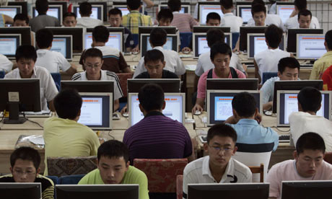
Different fields, where we are use computers
Business
Finance
Engineering and design
Entertainment
Scientific Research
Medicine
Education

Slide 3

Computers in business
Computers Facilitate Communication
Data Mining Benefits
Customer Relationship Management
Order Fulfillment
Design and Graphics
Marketing and Advertising
Using Computers to Manage People
Computer Administration

Slide 4

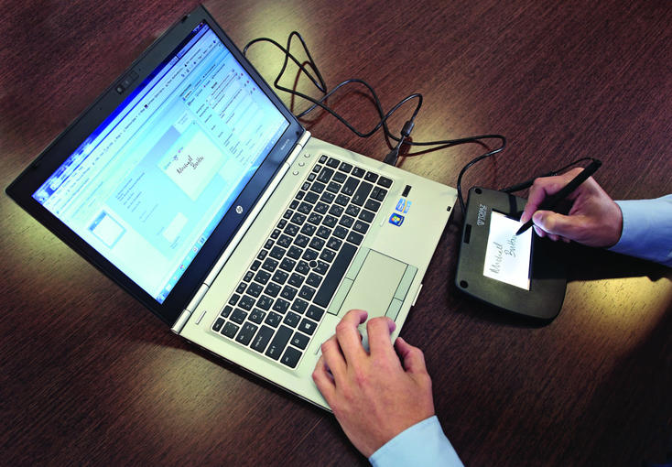
Computers Facilitate Communication

Slide 5

Data Mining Benefits

Slide 6

Customer Relationship Management

Slide 7
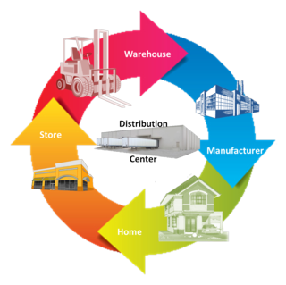
Order Fulfillment

Slide 8


Marketing and Advertising

Slide 9


Design and Graphics

Slide 10


Using Computers to Manage People

Slide 11

Computer Administration

Slide 12
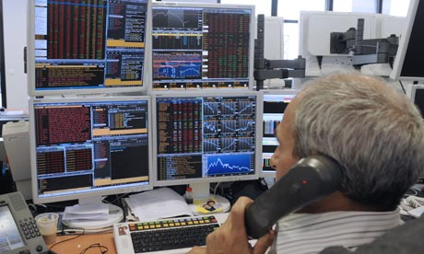
Computer in Finance
Communication
Spreadsheet Software
Data Storage
Programmed Transactions
Financial Information

Slide 13


Communication

Slide 14
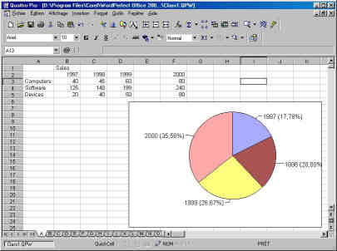
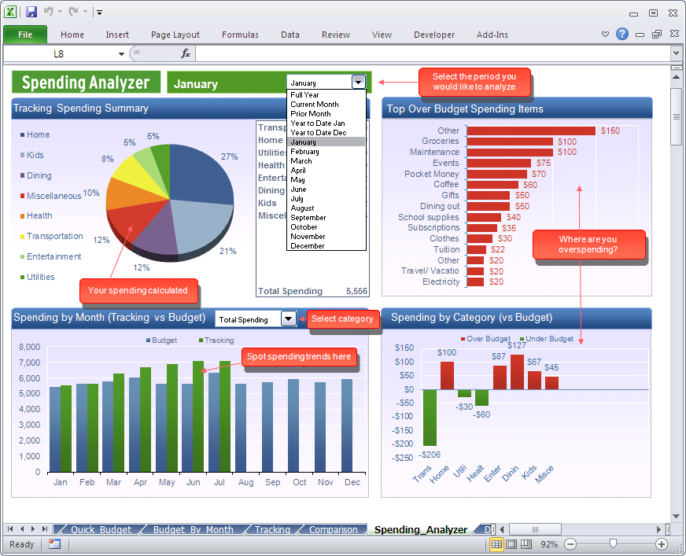
Spreadsheet Software

Slide 15


Data Storage

Slide 16
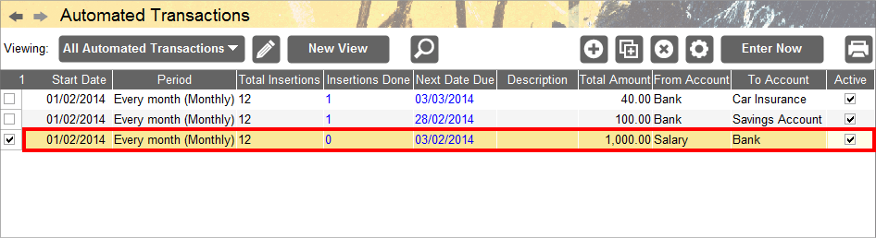
Programmed Transactions

Slide 17


Financial Information

Slide 18

Computers in Engineering
CAD
CFD
File Sending
Alterations

Slide 19
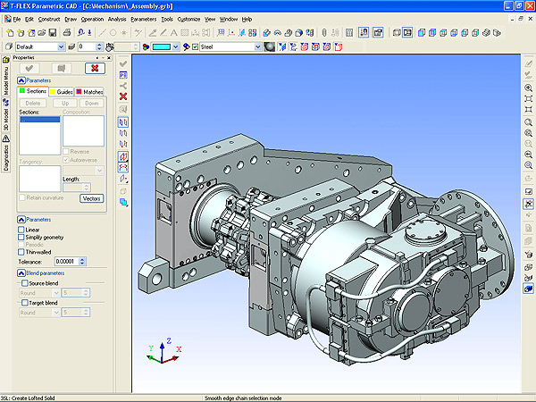
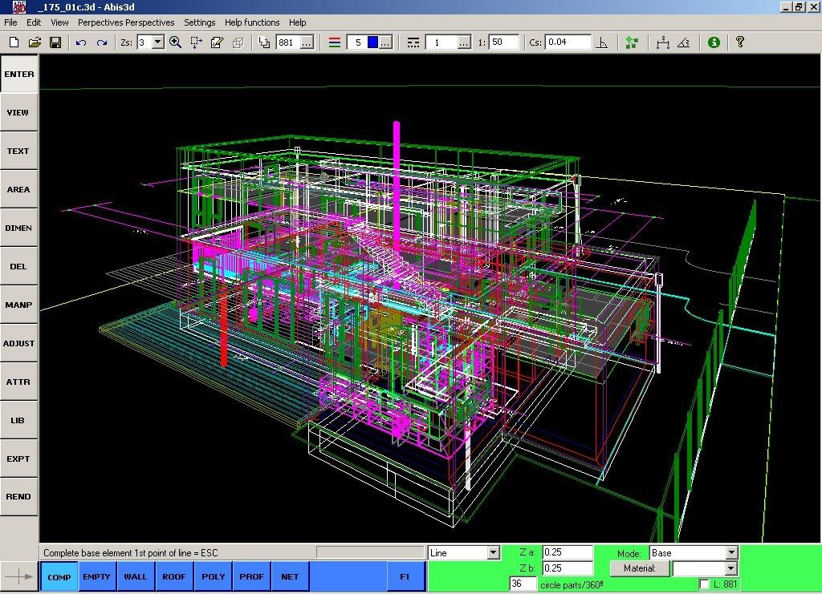
CAD

Slide 20
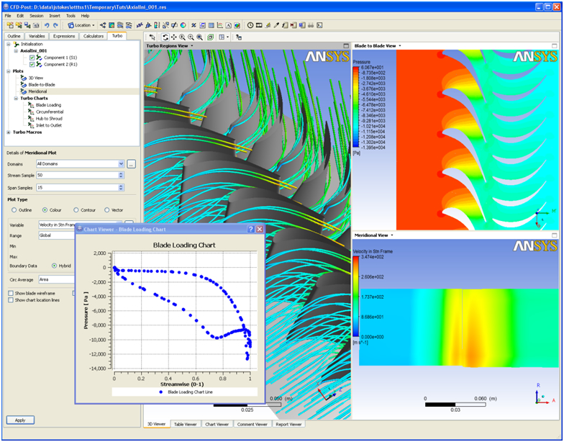
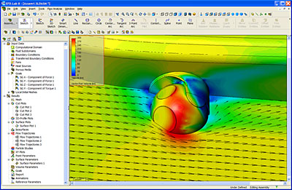
CFD

Slide 21
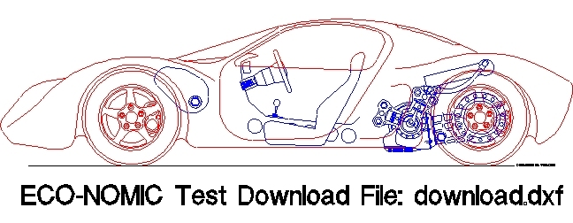
File Sending

Slide 22
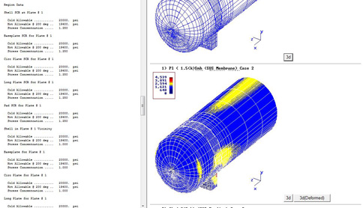

Alterations

Slide 23
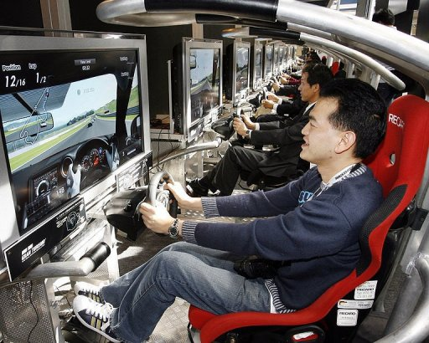
Computers in Entertainment
Music
Television and Movies
Art
Games

Slide 24
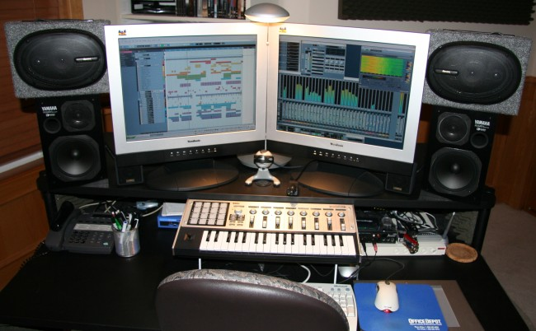
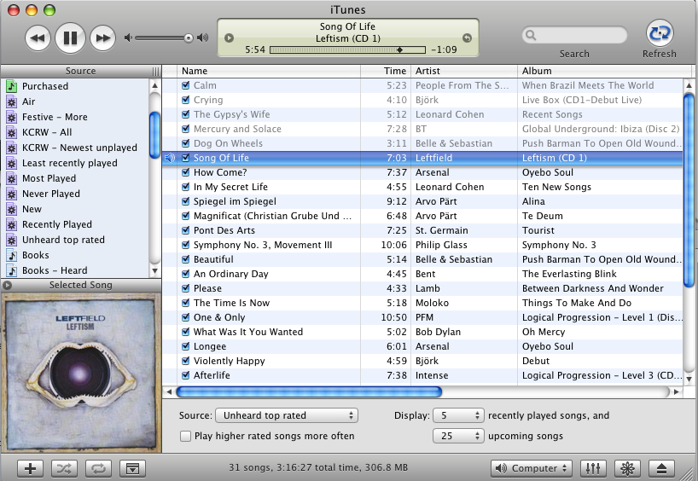
Music

Slide 25
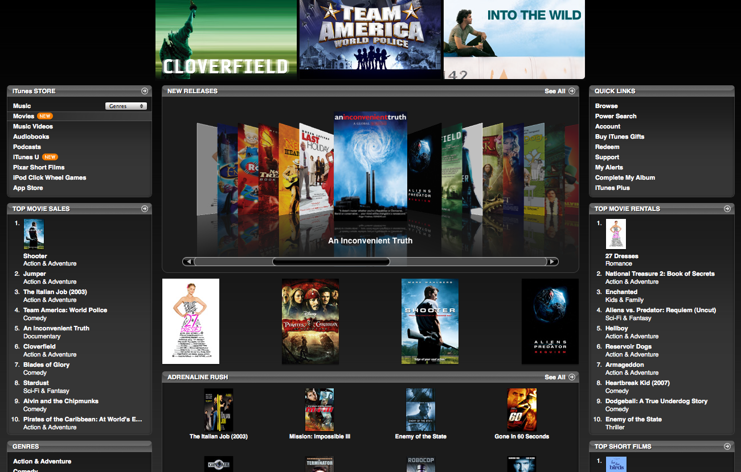
Television and Movies

Slide 26

Art

Slide 27
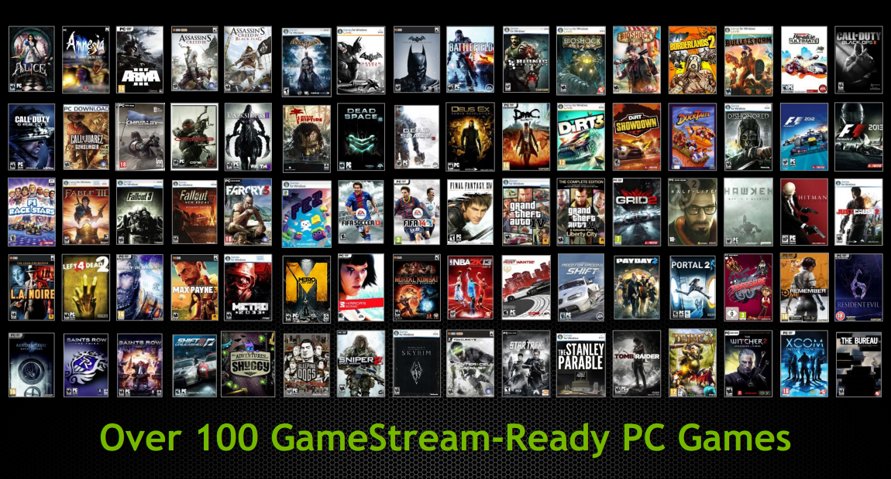
Games

Slide 28

Computers in Scientific Research
Complex Data Analysis
Solving Mathematical Equations
Prediction Modeling

Slide 29
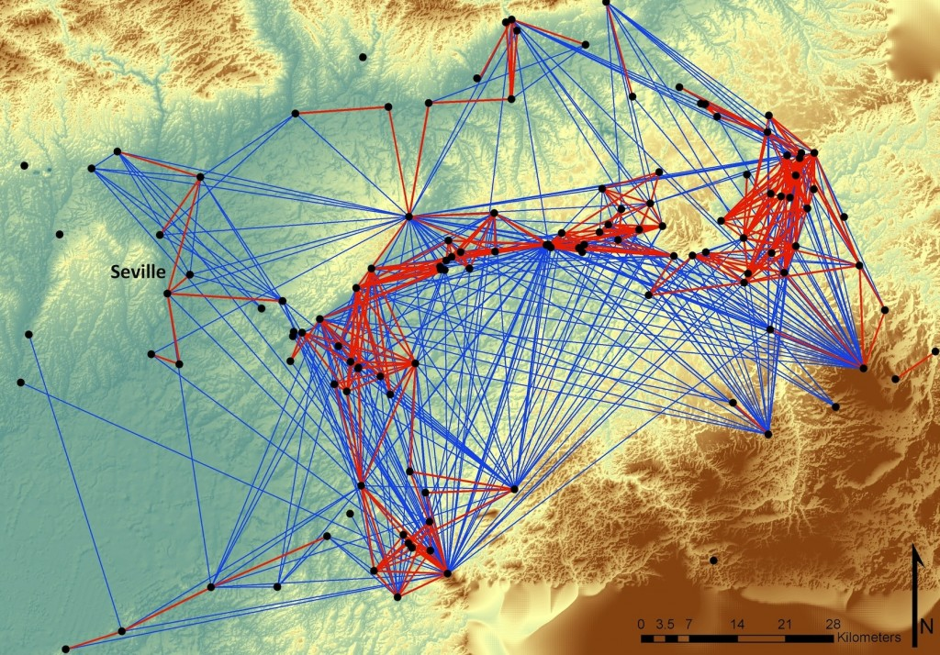
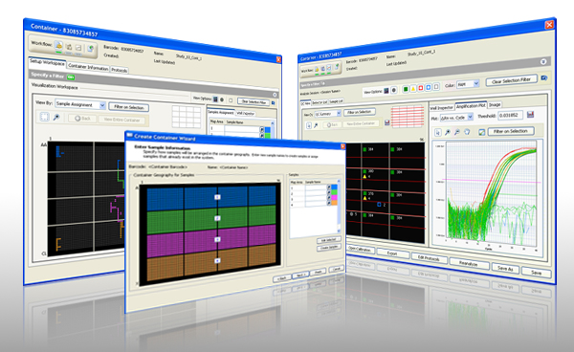
Complex Data Analysis

Slide 30
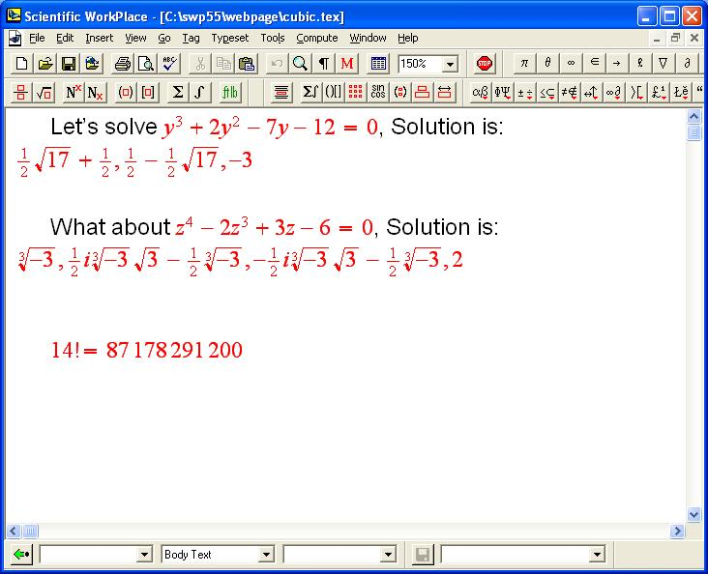
Solving Mathematical Equations

Slide 31
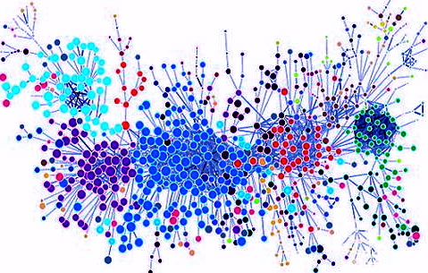
Prediction Modeling

Slide 32
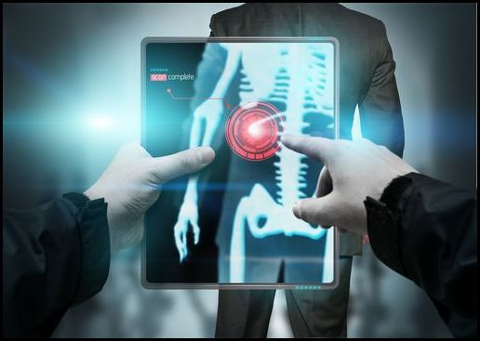
Computers in medical
Data Storage
Surgical Procedures
Diagnostic Tests
Knowledge Sharing

Slide 33
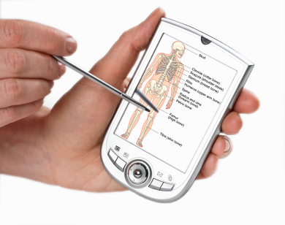
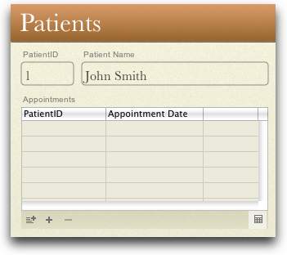
Data Storage

Slide 34
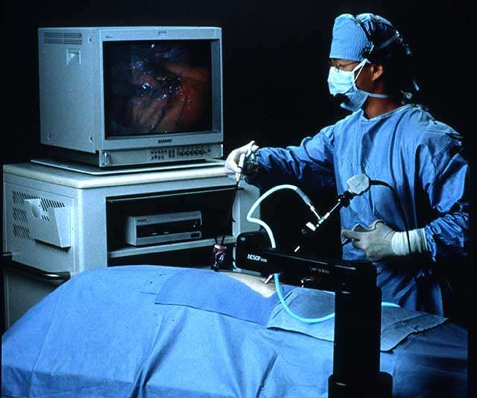
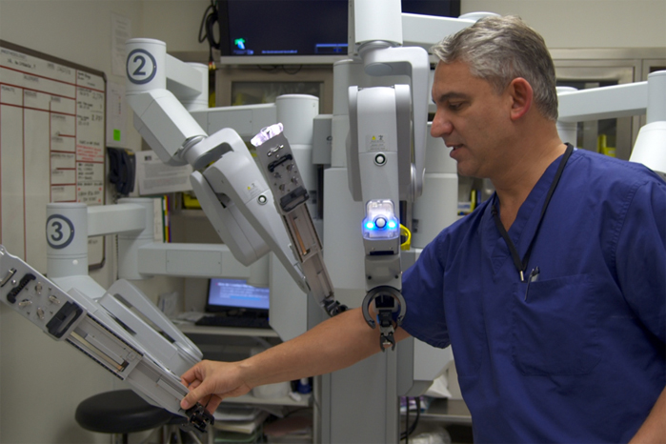
Surgical Procedures

Slide 35
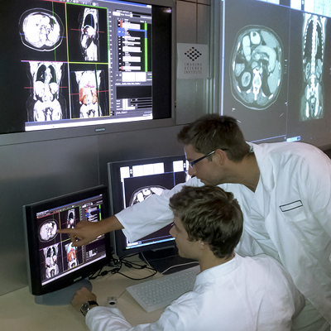
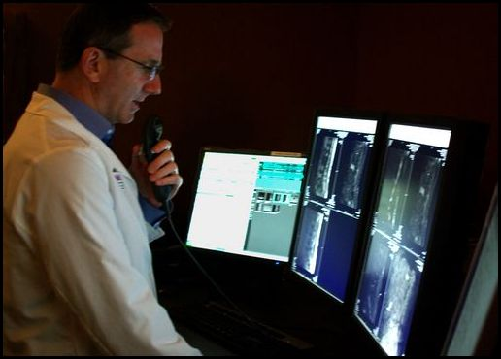
Diagnostic Tests

Slide 36

Computers in education
Audio-visual aids in teaching
Better presentation of information
Access to the Internet
Quick communication between students, teachers and parents

Slide 37


Online education

Slide 38


Presentation of information

Slide 39

Access to the Internet

